Slide 1

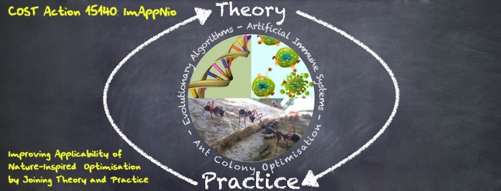

Unsupervised Machine Learning
Alberto TONDA, INRA(E), Université Paris-Saclay France

Slide 2
Dimensionality Reduction

Slide 3
Principal Component Analysis

Slide 4
T-SNE

Slide 5
Evolutionary D. Reduction
EvoGraphDice
Uses Symbolic Regression to create dimensions
Feedback from the user (interactive)

Slide 6
Self-Encoder

Slide 7
Clustering

